Slide 1


PhishNetGuard
A PHISHING WEBSITE DETECTION SYSTEM
Presented By: Vikrant Singh
Student Name: VIKRANT Singh
College Name: university institute of engineering Technology ,Kathua
Department: Computer Science(cse)
Email ID: RAJPUTVIKRANT977@GMAIL.COM
AICTE Student ID: STU681ba476772821746642038

Slide 2
OUTLINE
Problem Statement
Dataset and its Information
Data Visualization before Feature Scaling
Model Building
Result before feature Scaling
Data Visualization after feature Scaling
Result after Feature Scaling
Comparison Between original and Scaled data
Deep learning Model Evaluation
Final Comparison between the model
Conclusion and Reference

Slide 3
Problem Statement
Phishing attacks have become one of the most common and dangerous online threats, where fake websites are designed to resemble real ones, stealing personal information such as passwords or bank details. Traditional methods like blacklists or simple rule-based systems often overlook these new and cleverly disguised phishing sites. As a result, users remain vulnerable to scams. To address this issue, this project focuses on using Machine Learning and Deep Learning to develop smarter, automated systems that can detect phishing websites more accurately. By analysing aspects like URL structures and website content, the goal is to create models that can reliably distinguish between real and fake websites and help protect users from online fraud.

Slide 4
Dataset and its information
The dataset contains:
Features: URL-based indicators (like having ‘@’, length, HTTPS, etc.)
Target variable(Status): 1 (Phishing) or 0 (Legitimate)
Shape:
[11430,89]

Slide 5
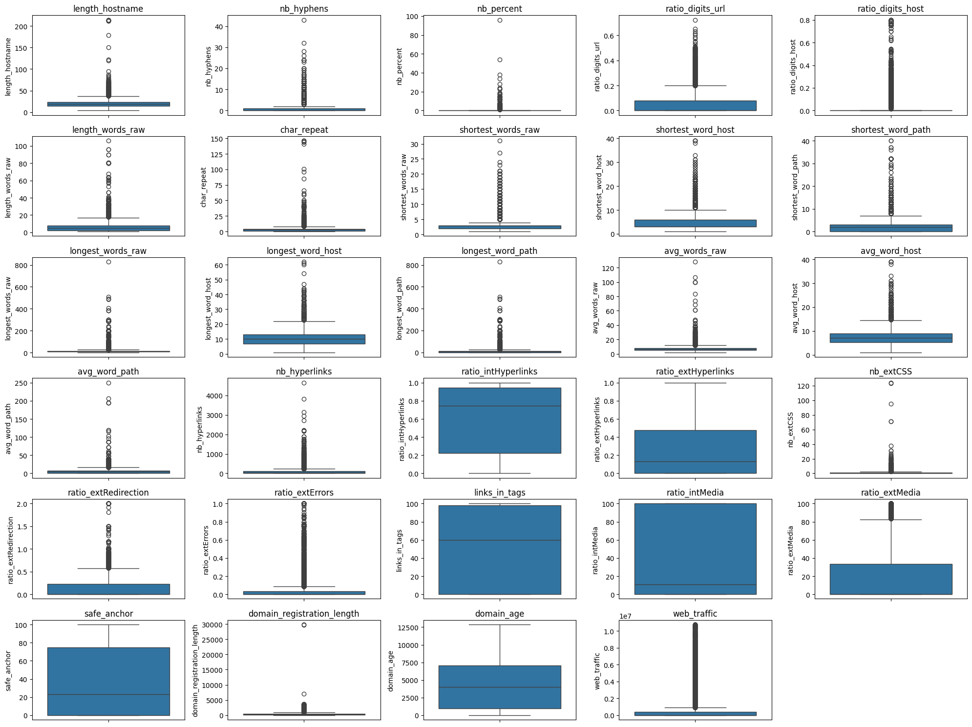
DATA VISUALIZATION BEFORE FEATURE SCALING

Slide 6
MODEL BUILDING
Machine Learning Models used:
Logistic Regression
Random Forest Classifier
Support Vector Machine (SVM)
Decision Tree
K-Nearest Neighbours (KNN)
Split dataset:
80% Training
20% Testing
Deep Learning Models used:
LSTM
BI-LSTM
epochs = 13/50
batch_size=32

Slide 7
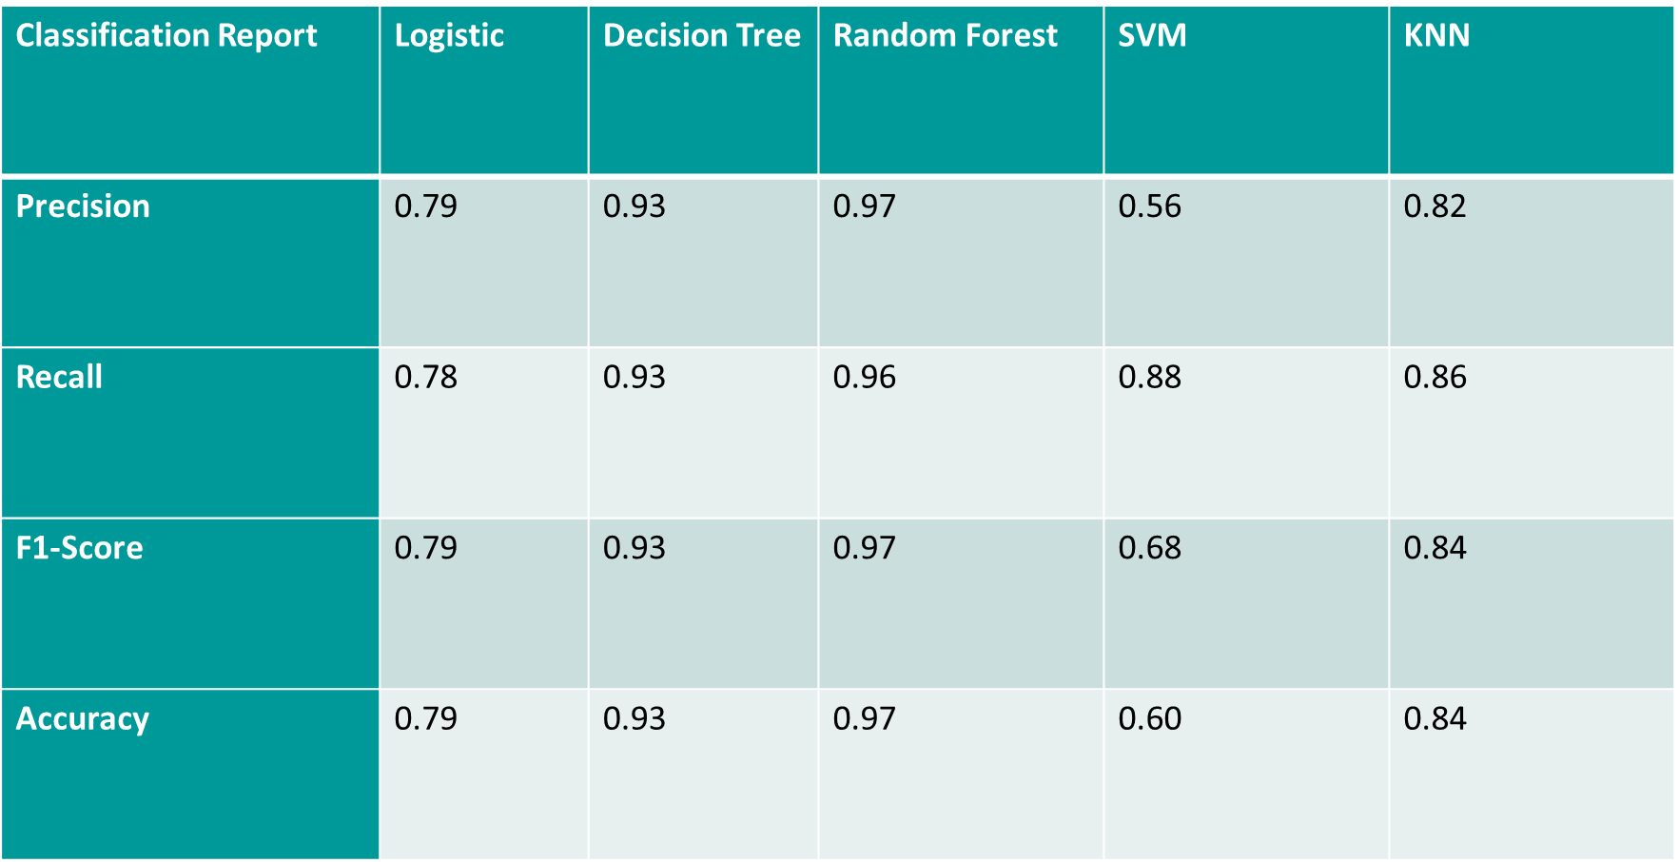
Result BEFORE FEATURE SCALING

Slide 8

DATA VISUALIZATION AFTER FEATURES SCALING

Slide 9
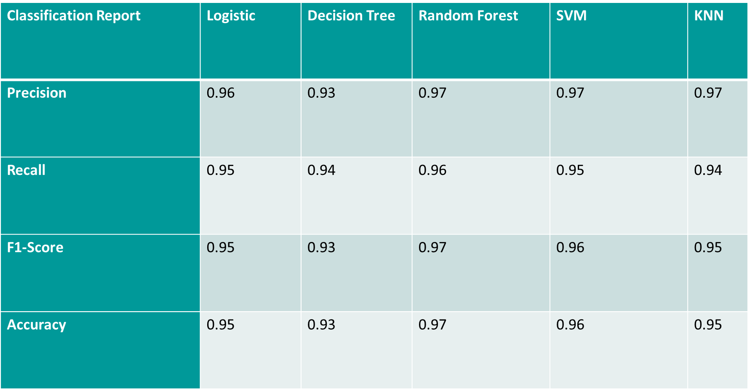
RESULT AFTER FEATURE SCALING

Slide 10
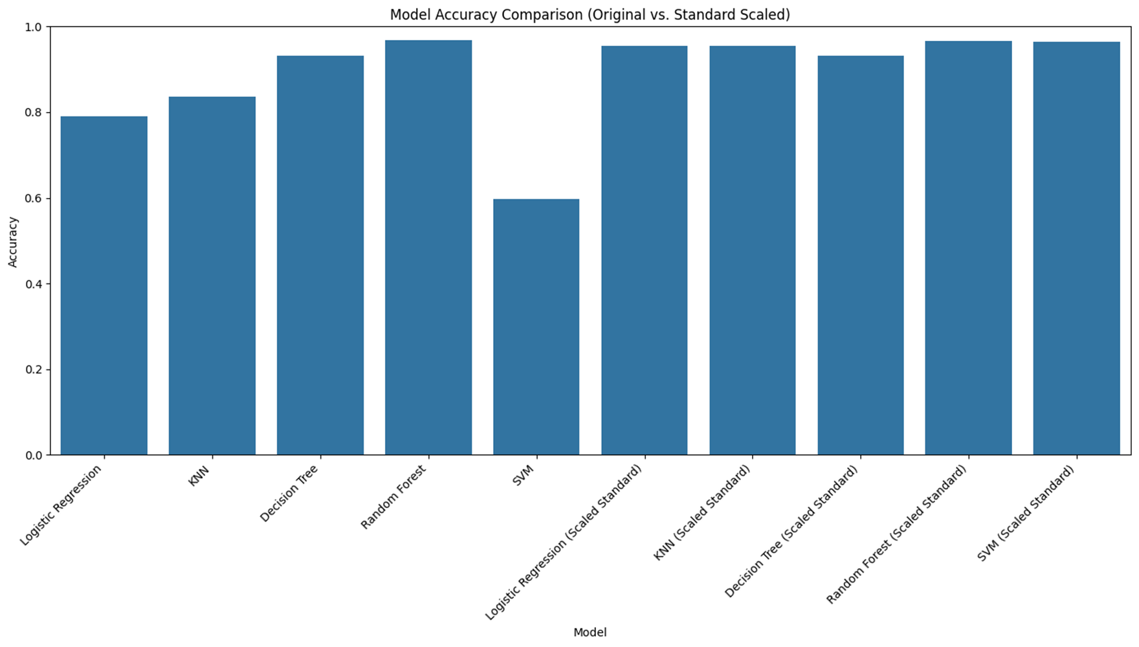

COMPARISON BETWEEN FEATURE AND SCALED DATA

Slide 11
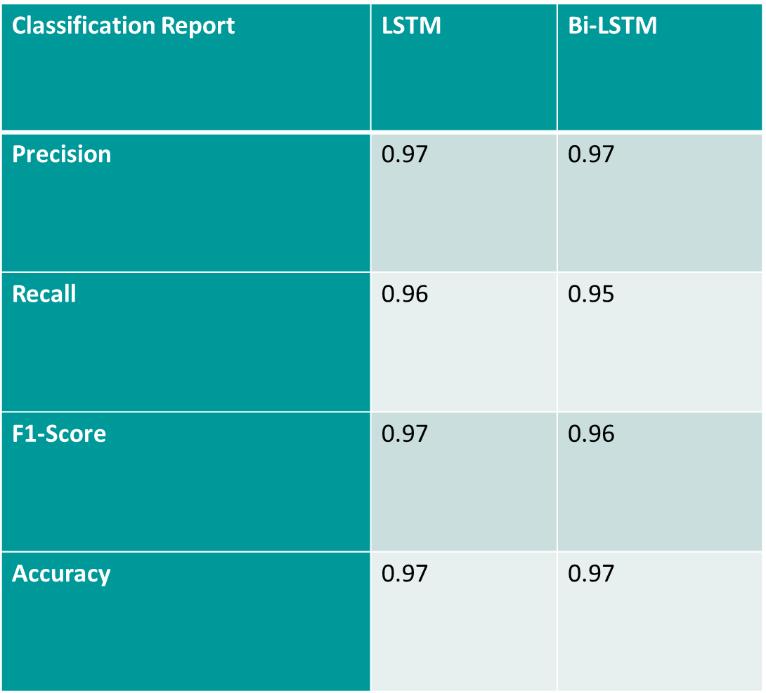
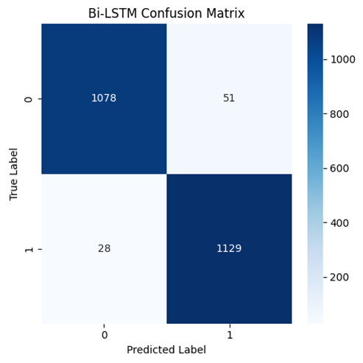

DEEP LEARNING MODEL EVALUATION

Slide 12
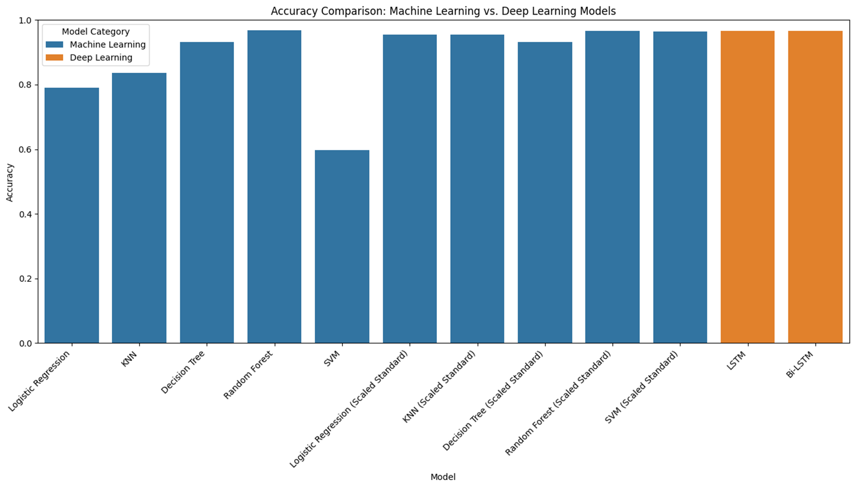
FINAL COMPARISON BETWEEN THE MODEL

Slide 13
FINAL COMPARISON BETWEEN THE MODEL

Slide 14
Societal impact
PhishNetGuard helps protect people from phishing attacks by using intelligent models to detect fake websites. This is especially useful for everyday internet users who may not recognize online threats. By preventing data theft and online fraud, the project promotes safer browsing and supports a more secure digital environment for individuals, schools, and businesses.

Slide 15
Conclusion and References
Phish Net Guard demonstrates the effectiveness of ML and DL in phishing website detection using a Kaggle dataset. Models like KNN, SVM, Logistic Regression, Decision Tree, Random Forest, LSTM, and Bi-LSTM were evaluated, with Random Forest and Bi-LSTM achieving the highest accuracy (97%) by capturing URL patterns effectively. The project shows how combining ML and DL provides a scalable, reliable solution. Future improvements include a user-friendly interface (e.g., Streamlit or Flask) and a browser extension for real-time phishing alerts
The dataset which I have used is :
SOURCE CODE:
GitHub Link: Link

Slide 16
Thank you

